Slide 1
Bismillahir rahmanir rahim
Welcome to Online Examination system
Developed by:
Md.Abdul Mukit
Md. Razu Ahamed
Md. Rasel
Md. Riaz Uddin

Slide 2
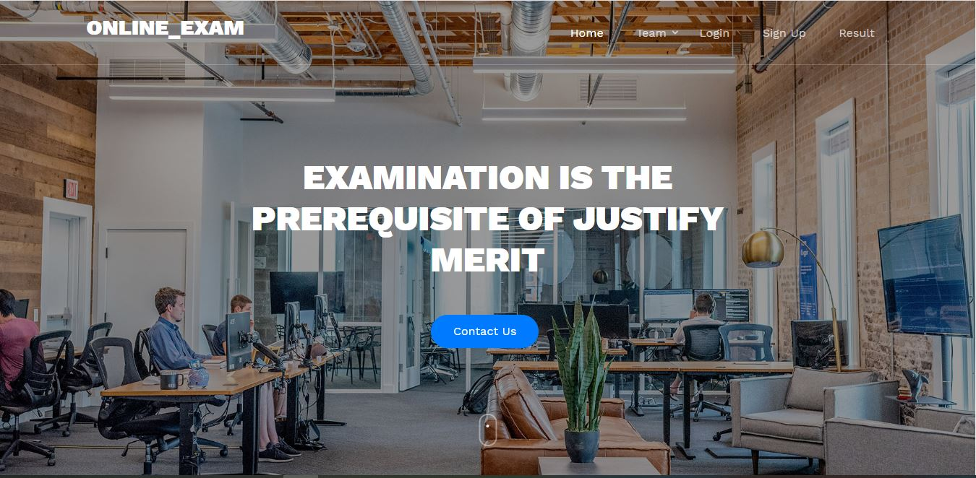
When a user browse into our site. He/she will see the following page like this:

Slide 3
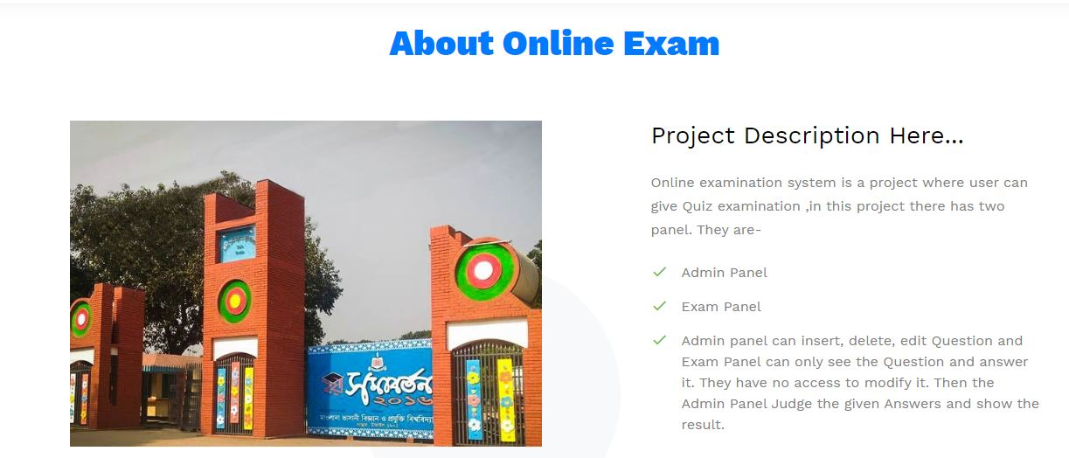
When a user click on About on the navigation bar. He/she will learn about our project :

Slide 4
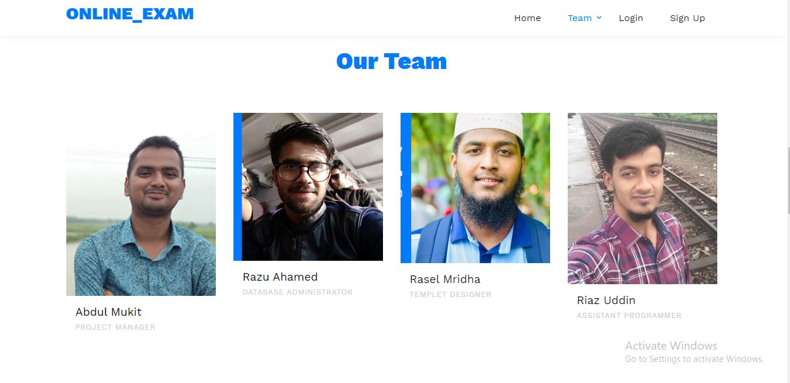
When a user click on Our Team on the navigation bar. He/she will know about our team members:

Slide 5
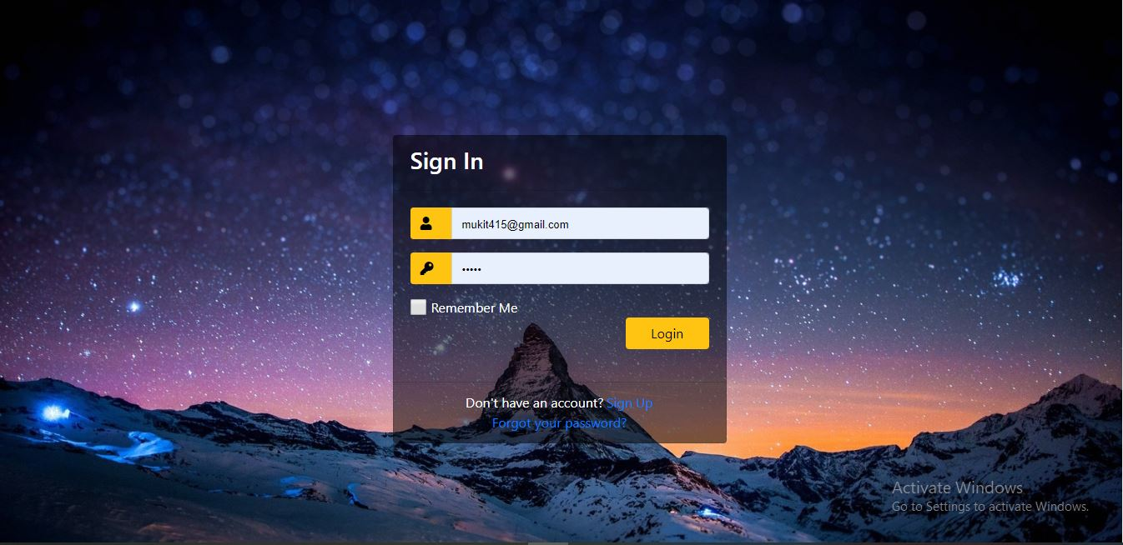
When a user click on Log in on the navigation bar. He/she will see some photos of our university:

Slide 6
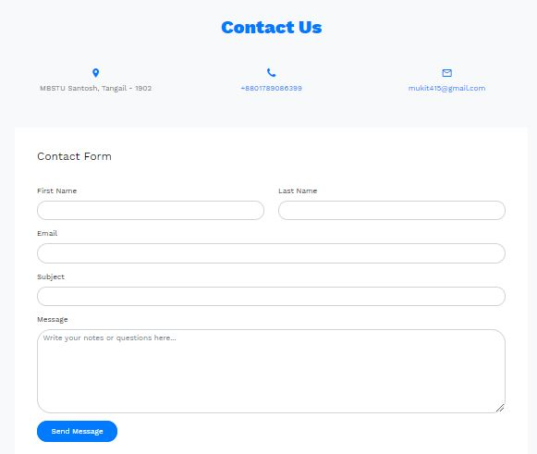
If any user will want to contact with us, he/she can click on Contact Us on the navigation bar. He/she can send any comment or message to us :

Slide 7
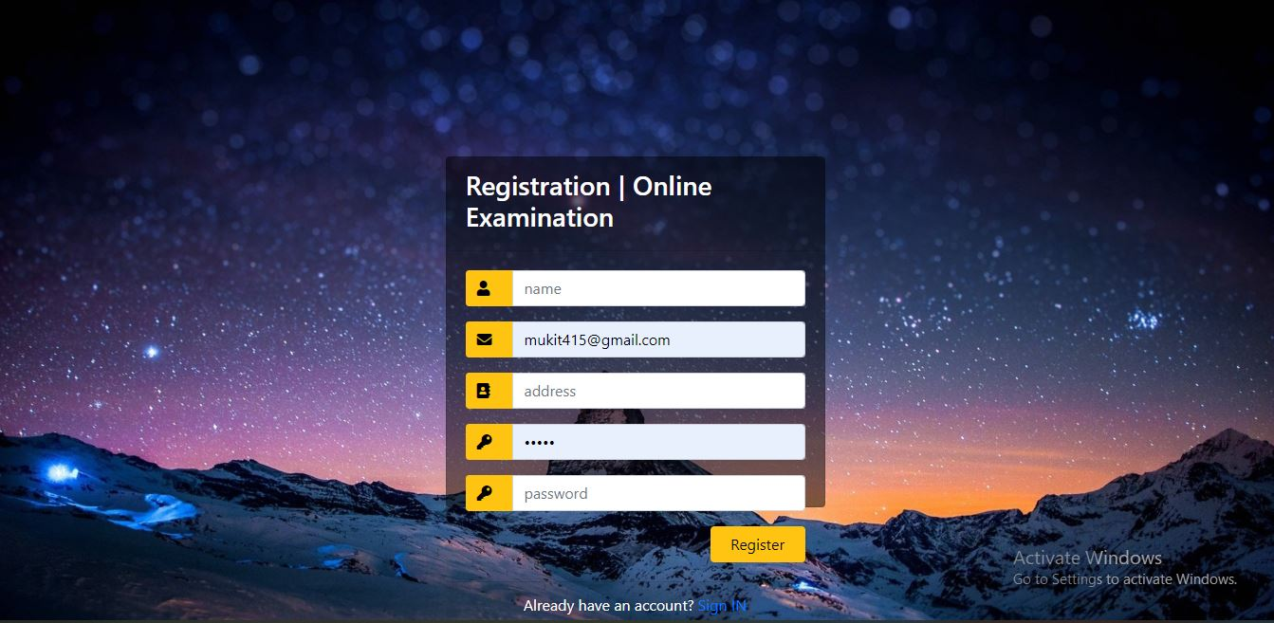
First of all, a student should sign up to this application. After completing the registration form, he must click on the register button.

Slide 8
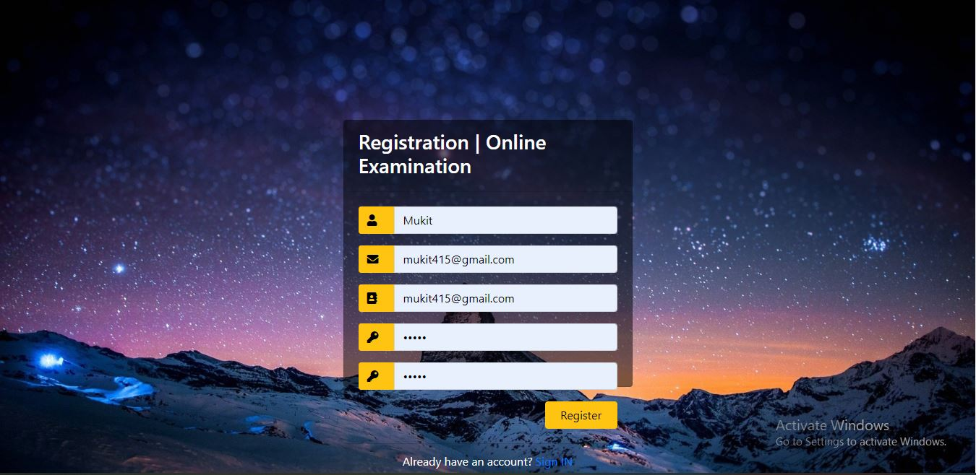
For example, a student (Md. Abdul Mukit) and his email id email: mukit415@gmil.com. After clicking on register button a mail will send to his email id and it will redirect to login page.

Slide 9
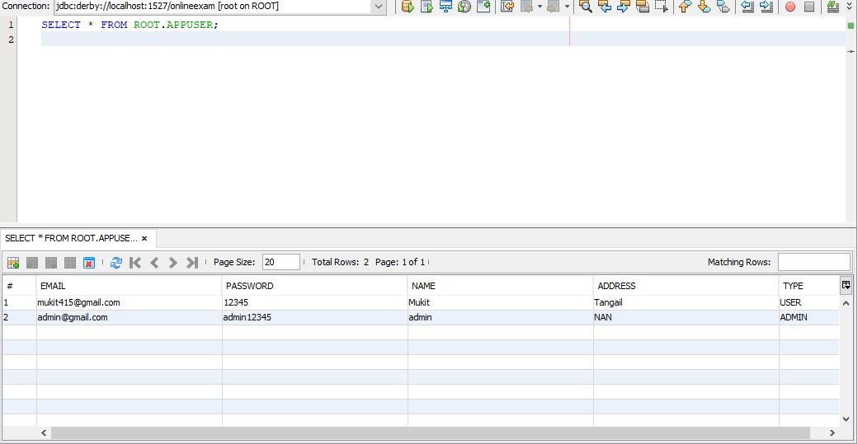
Then he is enlisted to the Database of the online exam where he can participate for the exam

Slide 10
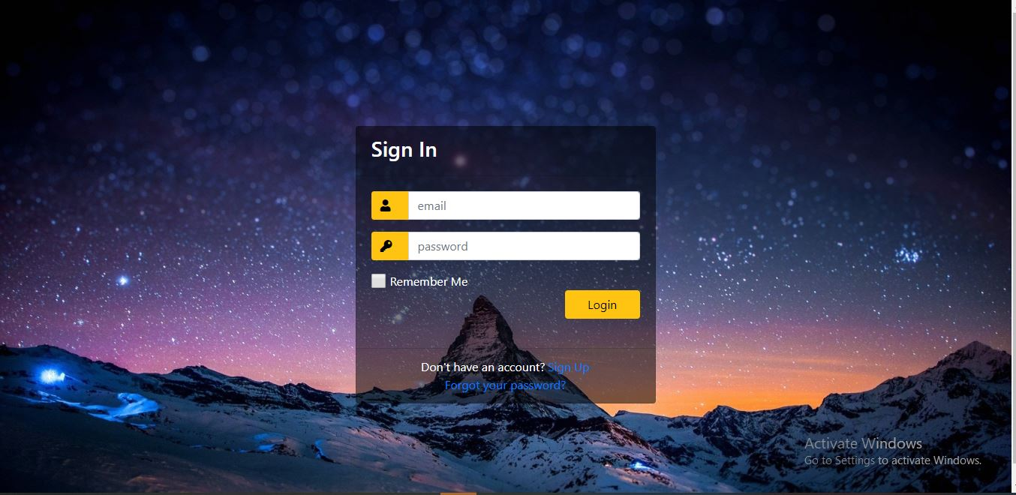
Then the applicant can get login and password to sit in the exam

Slide 11
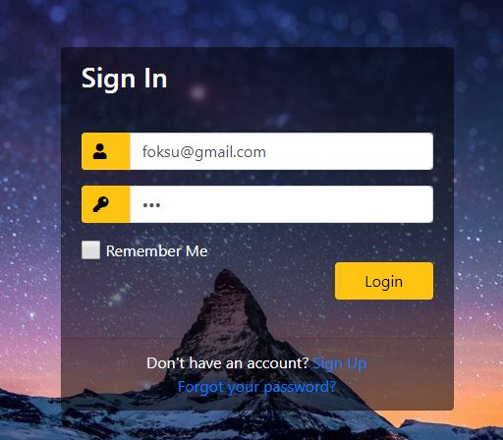
If the user id or password of the student is not valid then the login page will redirect with the following message.

Slide 12
For example, a student(Md. Abdul Mukit) who was previously registered to this application and sign in with his gmail and password.

Slide 13
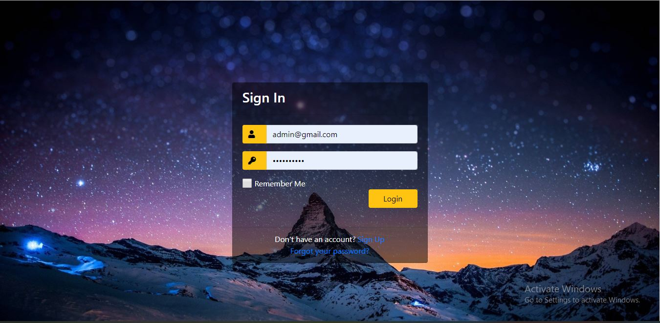
First of all admin login by admin user and password for insert questions

Slide 14
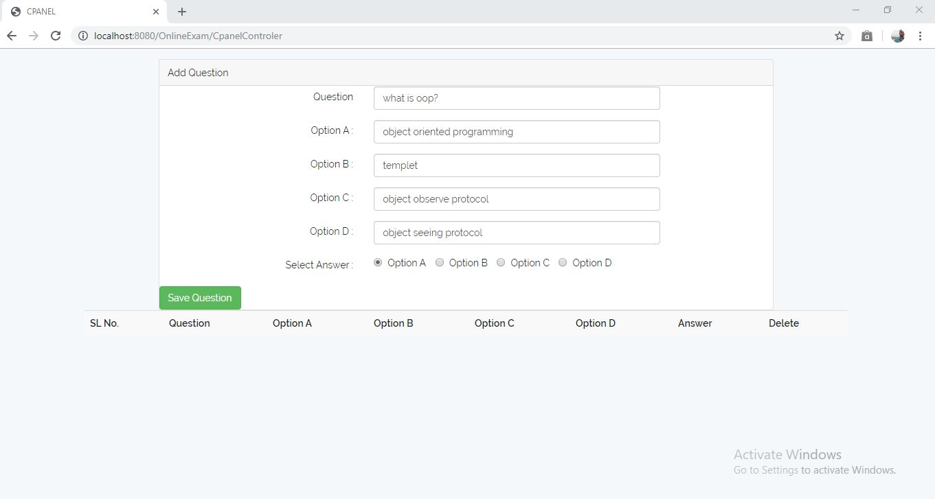
He can insert questions and option a,b,c,d and the correct answer which is stored in the databse

Slide 15
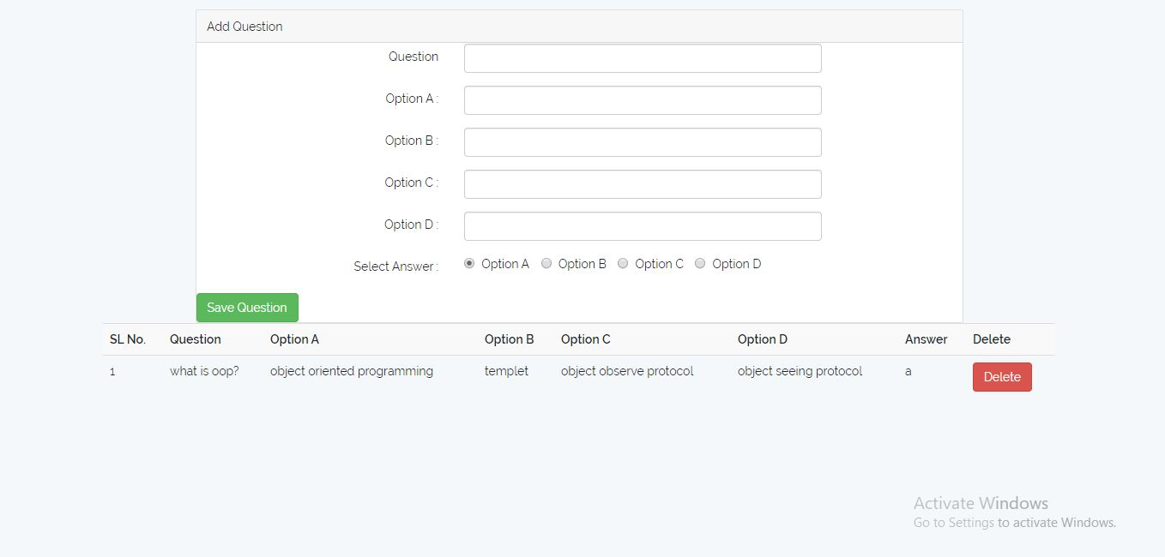
After clicking on the save Question button, then it will save in the database and the question and option can see the question paper and other things preserved in the cpanel

Slide 16
When the user sit for the exam ..he first log in by his gmail and password

Slide 17
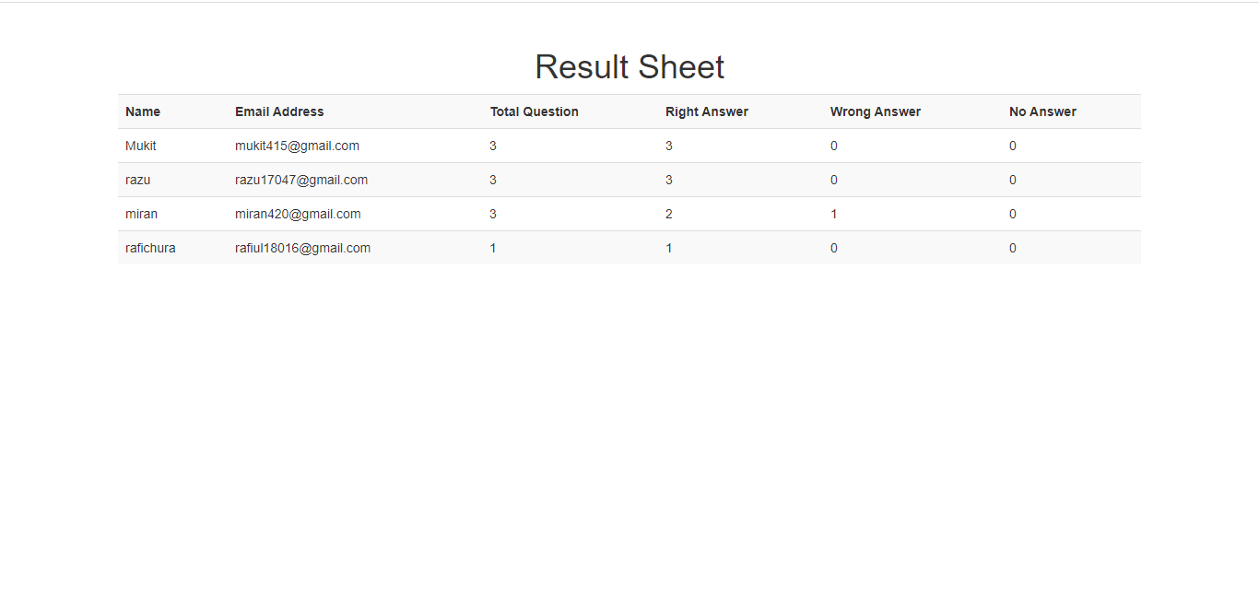
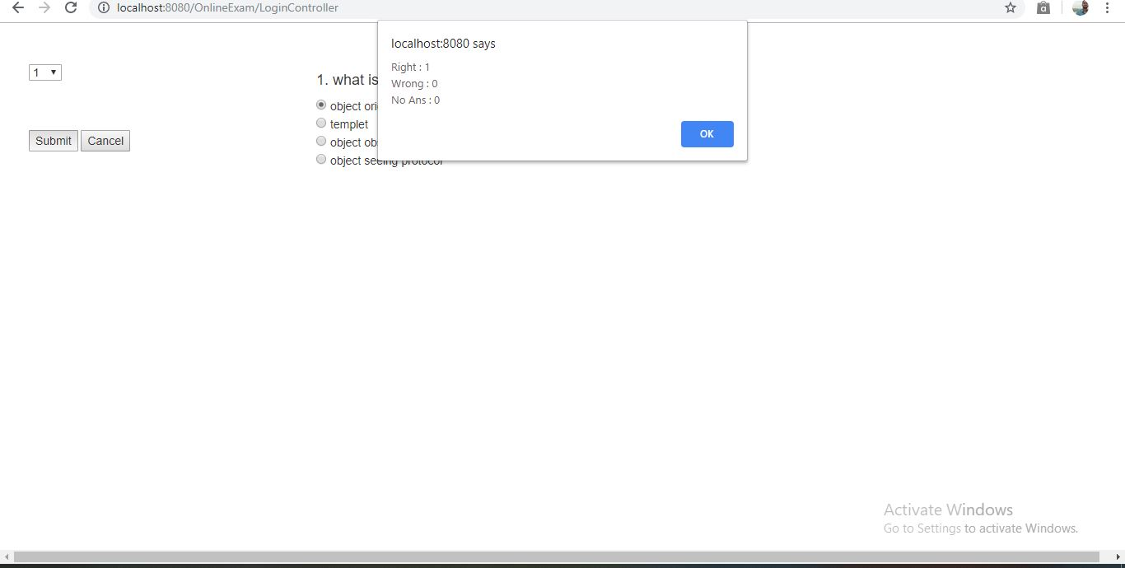
Then he gets the question paper and option of the question where he chose his desirable option and submit it by compeleting all the answers and he will notify for that the no. of correct and incorrect answer

Slide 18
Appendix of this project:
Frontend Code: | Html, css, javascript, jsp, Bootstrap theme.
Backend Code: | Java, servlet,jsp,database.

Slide 19
Group Members Activity:
Md. Abdul Mukit IT-17055 (Team Lead) | Give the concept to build this project. Design and Program the backend code. Work with some frontend code.
Md. Razu Ahamed IT-17047 | Associate of Mukit with his concept for this project. He design the database for this project. And work with some backend code.
Md. Rasel IT-17049 | Associate of Mukit with his concept for this project. He is the templet designer And work with some frontend code.
Md. Riaz Uddin IT-17059 | Associate of Mukit with his concept for this project. He is the assistant programmer And work with some frontend and backend code with Mukit and Rasel.

Slide 20
Thank You

